Slide 1
Multiple blood feeding case studies

Slide 2
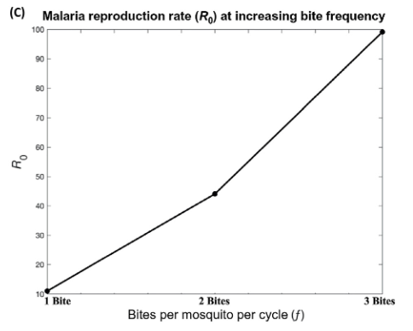
Multiple blood feeding may multiple transmission
More feeding attempts
3x increase in biting frequency
→ 10x increase in in transmission
More contact with hosts
More opportunities for disease transmission
Tedrow, R. E., P. A. Zimmerman, and K. C. Abbott. 2019. Multiple Blood Feeding: A Force Multiplier for Transmission. Trends in parasitology 35:949–952.

Slide 3
Drivers of multiple* blood feeding
Larval conditions
Less “healthy” adults may need multiple blood meals to obtain sufficient nutrients for egg formation and oviposition
Meal diversity
Feeding on a variety of blood meal sources may lead to higher fecundity
Interruption by defensive behavior
Defensive behaviors of animals can destroy mosquitoes
Some animals feed on mosquitoes
*some authors differentiate between “multiple” and “interrupted” blood feeding

Slide 4
Should multiple blood feeding behavior increase or decrease transmission potential?
Increase
Decrease
More contact events, more opportunities for transmission
(Potentially) allows for full cycle of transmission (host→vector→host) in a single gonotrophic cycle
Shorter periods of contact, smaller probability of successful transmission
Multiple blood feeding is risky; decreases mosquito lifespan and infectious period

Slide 5
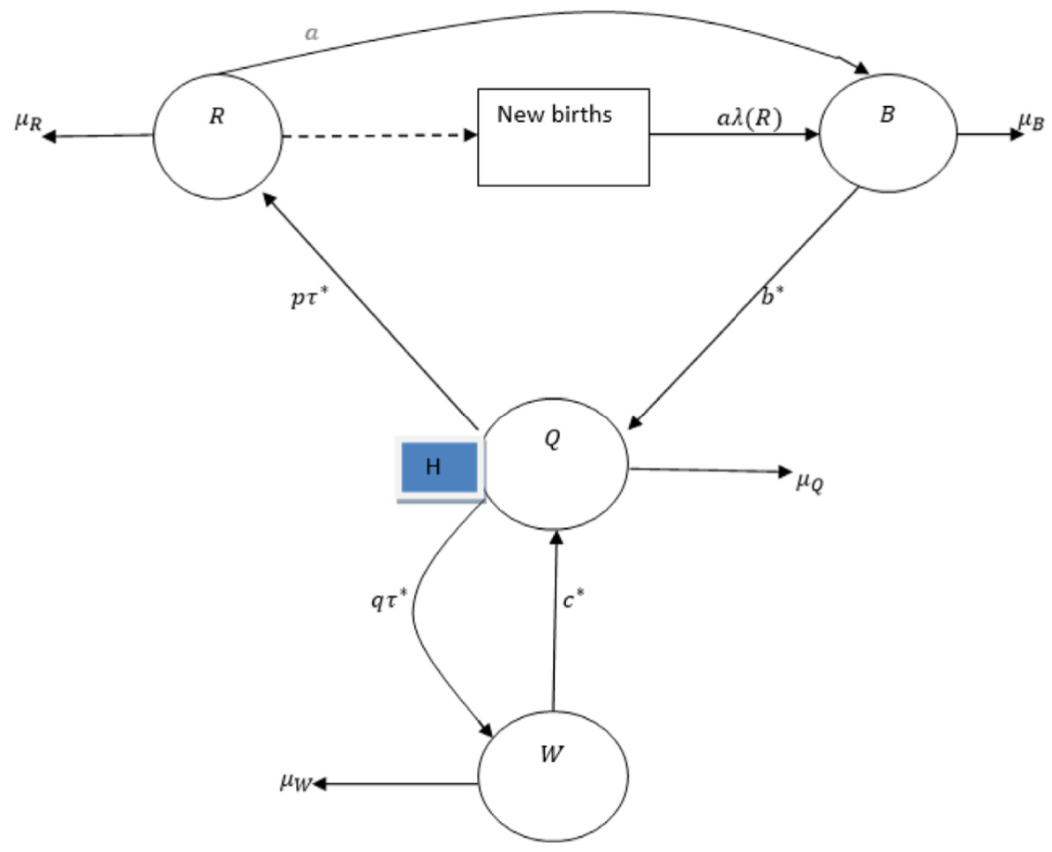
Past models of multiple blood feeding
Many authors have incorporated multiple blood feeding into models simply by multiplying the contact rate
Ghakanyuy et al. (2022) explicitly model the possibility of failed blood feeding leading to multiple feeds per gonotrophic cycle
Christofferson et al. (2022) developed an IBM of transmission in a 2-person household, allowing for multiple feeds by the the mosquito
Anderson and Roitberg (1999) developed a stochastic simulation model to evaluate relative dis/advantages of multiple blood in regard to mosquito fitness
This list is by no means complete

Slide 6
Goal
Long-term:
We aim to formalize how multiple blood feeding is represented in ODE models so that this process can be simulated as naturally as extrinsic incubation periods or other similar processes.
For now:
Develop simple models of types of multiple blood feeding processes (e.g. larval rearing conditions vs. interrupted feeding)
Determine how differences in multiple blood feeding processes might drive differences in how multiple blood feeding impacts transmission
Does the form of the process impact the purported increasing relationship between multiple feeding and transmission potential?

Slide 7
Case study models
Fate model
Disrupt model
The number of blood meals needed for repletion is determined at birth
This number depends on the conditions in which the larval mosquito was reared
Worse conditions lead to the need for multiple blood meals
The number of blood meals needed for repletion depends on feeding success, which may be limited by host defensive behaviors
At each feeding attempt, mosquitoes have some probability of feeding to repletion or requiring another blood meal

Slide 8
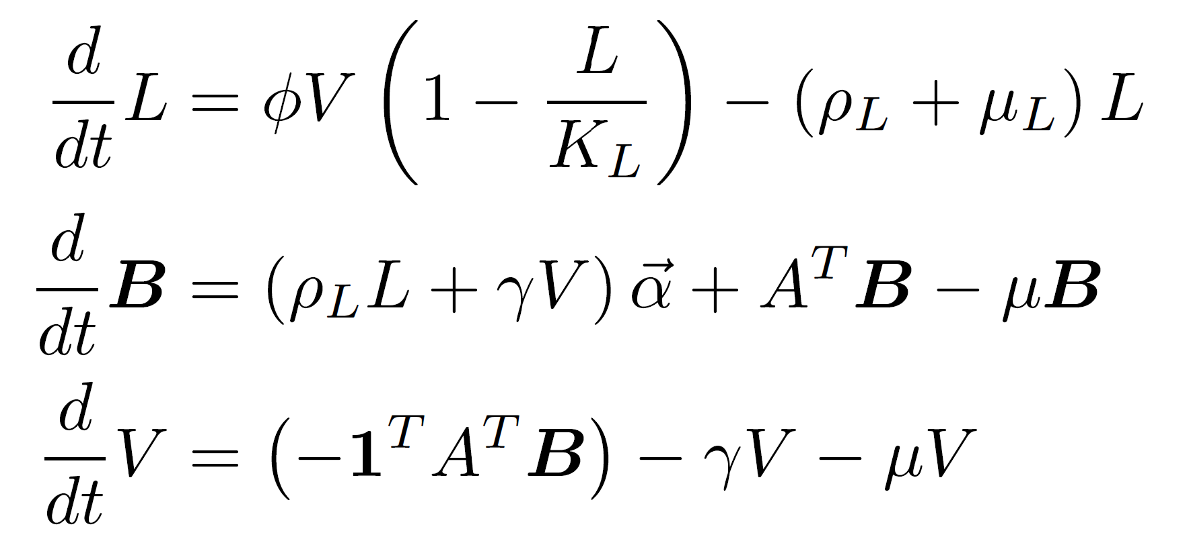
General form of the case study models
Larval recruitment
Larval or aquatic stages
Larval development
Transitions within blood-feeding stages
Blood-feeding stages
Oviposition stage
From blood-feeding to oviposition

Slide 9
“Disrupt” model
Aquatic stage
Blood-feeding
Blood-feeding
Blood-feeding
Blood-feeding
Ovipositing
At each blood-feeding stage, a mosquito has a possibility of reaching repletion or requiring additional blood meals
The waiting time to leave the blood-feeding stages is represented by a Coxian distribution
Notes:
Mixture of Coxian distributed waiting time and exponential (minimum of the two)

Slide 10


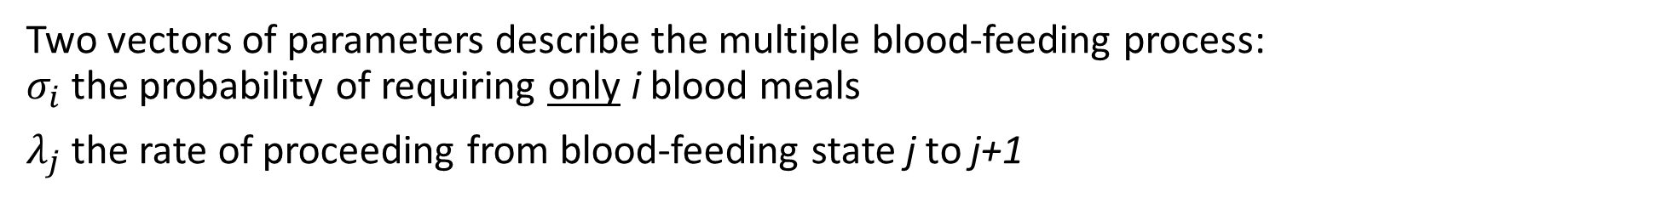




“Disrupt” model
$$σ_{1}λ_{1}$$
$$σ_{2}λ_{2}$$
$$σ_{3}λ_{3}$$
Aquatic stage
Blood-feeding
$$(1−σ_{1}) λ_{1}$$
Blood-feeding
$$(1−σ_{2})λ_{2}$$
Blood-feeding
Blood-feeding
$$λ_{k}$$
Ovipositing
Two vectors of parameters describe the multiple blood-feeding process: $σ_{i}$ the probability of requiring only i blood meals
$λ_{j}$ the rate of proceeding from blood-feeding state j to j+1

Slide 11







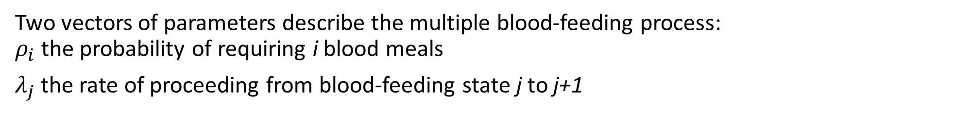






“Fate” model
Blood-feeding
$$λ_{1,1}$$
Oviposition
$$κ_{1}$$
$$λ_{2,1}$$
$$λ_{2,2}$$
Blood-feeding
Blood-feeding
Oviposition
$$κ_{2}$$
$$κ_{3}$$
$$λ_{3,1}$$
$$λ_{3,2}$$
$$λ_{3,3}$$
Aquatic stage
Blood-feeding
Blood-feeding
Blood-feeding
Oviposition
$$κ_{k}$$
$$λ_{k,1}$$
$$λ_{k,2}$$
$$λ_{k,k}$$
Blood-feeding
Blood-feeding
Blood-feeding
Blood-feeding
Oviposition
Two vectors of parameters describe the multiple blood-feeding process: $ρ_{i}$ the probability of requiring i blood meals
$λ_{j}$ the rate of proceeding from blood-feeding state j to j+1

Slide 12
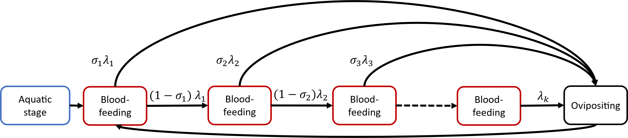
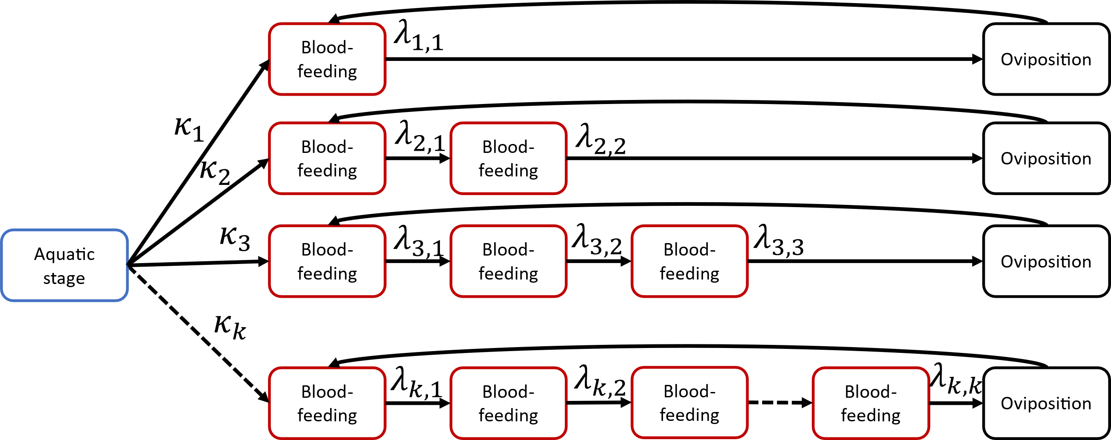
“Disrupt” model
“Fate” model
Notes:
Given a fixed extrinsic incubation period, what fraction of compartments are potentially transmissible.
Assume all mosquitoes acquire infection on their first bite.

Slide 13
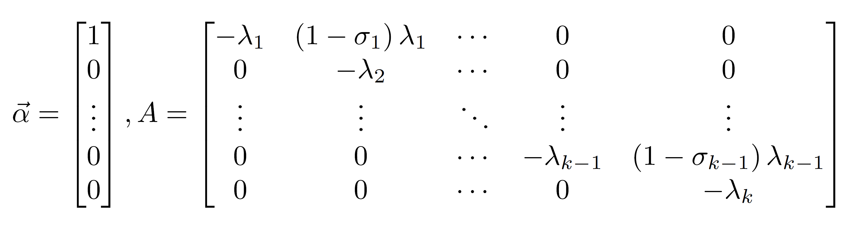
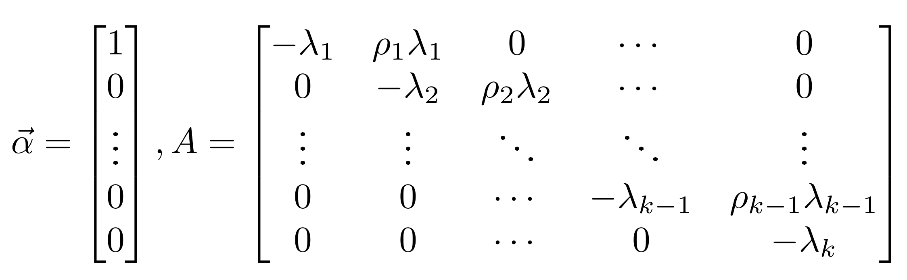
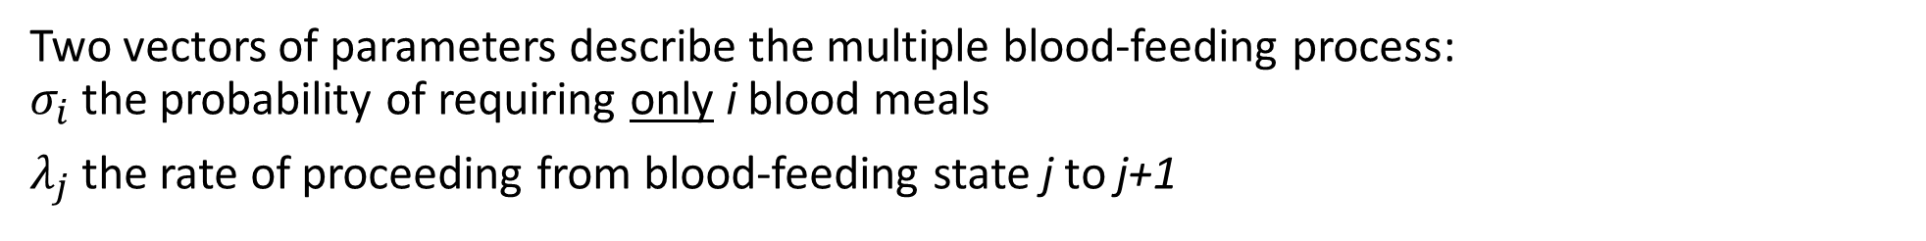
“Disrupt” model, specified
Two vectors of parameters describe the multiple blood-feeding process: $σ_{i}$ the probability of requiring only i blood meals
$λ_{j}$ the rate of proceeding from blood-feeding state j to j+1

Slide 14
“Fate” model
Blood-feeding
Oviposition
Blood-feeding
Blood-feeding
Oviposition
Aquatic stage
Blood-feeding
Blood-feeding
Blood-feeding
Oviposition
Blood-feeding
Blood-feeding
Blood-feeding
Blood-feeding
Oviposition
Larval rearing conditions determine the distribution of mosquitoes needing 1, 2,…, k blood meals to attain the repletion state

Slide 15




“Fate” model
Blood-feeding
$$λ_{1,1}$$
Oviposition
$$ρ_{1}$$
$$λ_{2,1}$$
$$λ_{2,2}$$
Blood-feeding
Blood-feeding
Oviposition
$$ρ_{2}$$
$$ρ_{3}$$
$$λ_{3,1}$$
$$λ_{3,2}$$
$$λ_{3,3}$$
Aquatic stage
Blood-feeding
Blood-feeding
Blood-feeding
Oviposition
$$ρ_{k}$$
$$λ_{k,1}$$
$$λ_{k,2}$$
$$λ_{k,k}$$
Blood-feeding
Blood-feeding
Blood-feeding
Blood-feeding
Oviposition
Two vectors of parameters describe the multiple blood-feeding process: $ρ_{i}$ the probability of requiring i blood meals
$λ_{j}$ the rate of proceeding from blood-feeding state j to j+1

Slide 16









Alternative “Fate” model: one oviposition compartment
Blood-feeding
$$ρ_{1}$$
$$λ_{1}$$
Blood-feeding
Blood-feeding
$$ρ_{2}$$
$$ρ_{3}$$
$$λ_{1}$$
$$λ_{2}$$
Aquatic stage
Blood-feeding
Blood-feeding
Blood-feeding
Oviposition
$$ρ_{k}$$
Blood-feeding
$$λ_{1}$$
Blood-feeding
$$λ_{2}$$
Blood-feeding
Blood-feeding
The previous model maintains the history of individuals in the form of the number of bites needed to reach repletion.
This formulation better follows the framework of Paul Hurtado’s work, where individuals lose their “identity” upon leaving a series of compartments.

Slide 17
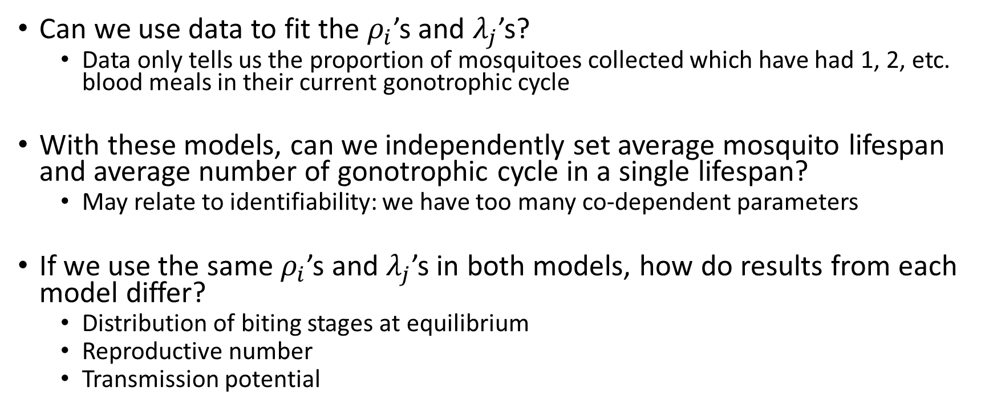
Questions
Can we use data to fit the $ρ_{i}$’s and $λ_{j}$’s?
Data only tells us the proportion of mosquitoes collected which have had 1, 2, etc. blood meals in their current gonotrophic cycle
With these models, can we independently set average mosquito lifespan and average number of gonotrophic cycle in a single lifespan?
May relate to identifiability: we have too many co-dependent parameters
If we use the same $ρ_{i}$’s and $λ_{j}$’s in both models, how do results from each model differ?
Distribution of biting stages at equilibrium
Reproductive number
Transmission potential

Slide 18
Analyses
Compare the conditions for existence and stability of disease-free equilibria
Find stable population distribution among blood-feeding stages and use this to fit multiple blood-feeding parameters to data
Compare the conditions for existence and stability of endemic equilibria
Develop some representative simulations of transient and equilibrium dynamics

Slide 19
Preliminary analysis of the “Disrupt” model
Probability of going from blood-feeding stage 1 to stage i
Total probability of going from blood-feeding stage 1 to oviposition stage
Probability of going to oviposition stage from stage i

Slide 20
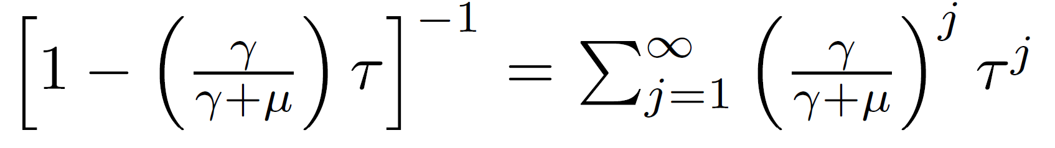
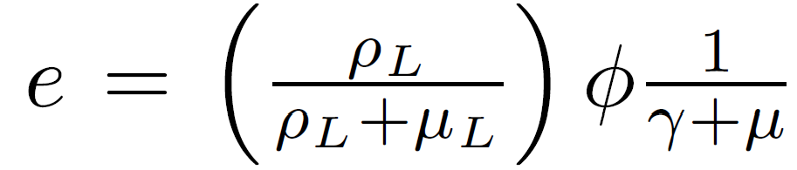

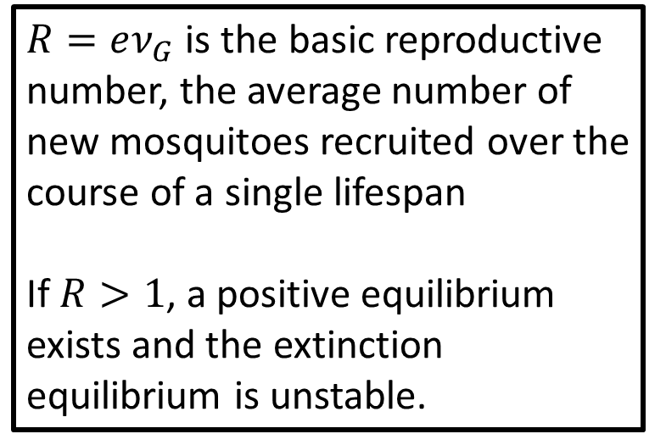
Preliminary analysis of the “Disrupt” model
Probability of surviving all blood-feeding stages
Average number of gonotrophic cycles in a lifespan
$$ν_{G}=$$
Probability of surviving the oviposition stage
$R=eν_{G}$ is the basic reproductive number, the average number of new mosquitoes recruited over the course of a single lifespan
If $R>1$, a positive equilibrium exists and the extinction equilibrium is unstable.
Average number of new mosquitoes recruited by one mosquito in a single gonotrophic cycle
Probability of surviving the aquatic stage
Average number of eggs laid in one gonotrophic cycle

Slide 21
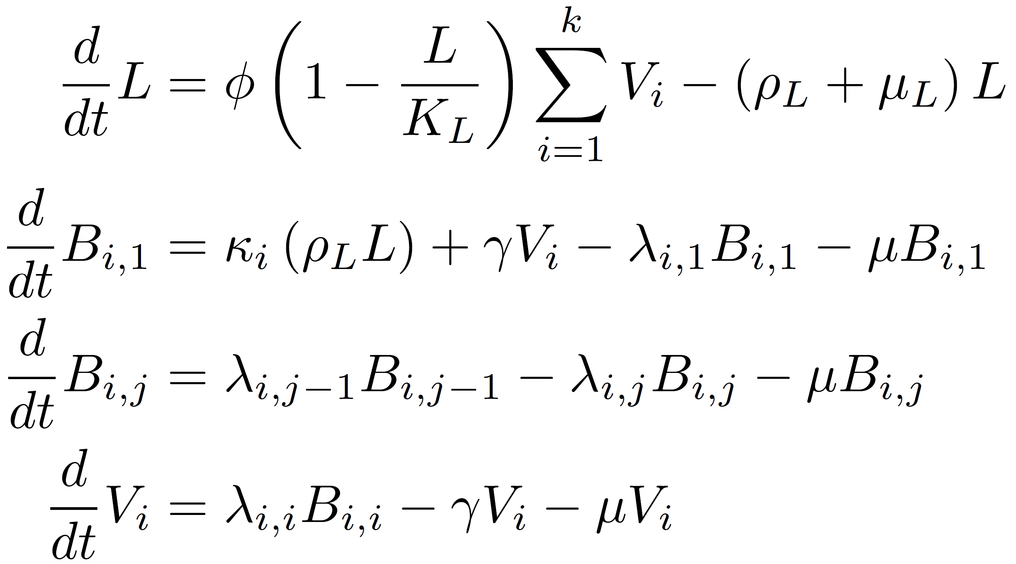
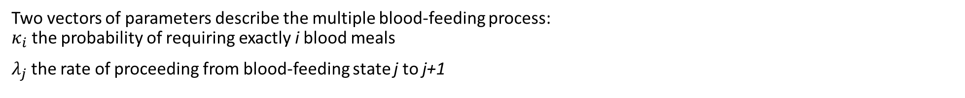

“Fate” model, specified
Larval or aquatic stages
Blood-feeding stages
$$, 1<j≤i≤k$$
Oviposition stages
Cannot be represented using the matrix-vector form described in Hurtado and Kirosingh (2019) because of the additional index on the blood-feeding stages
Two vectors of parameters describe the multiple blood-feeding process: $κ_{i}$ the probability of requiring exactly i blood meals
$λ_{j}$ the rate of proceeding from blood-feeding state j to j+1

Slide 22
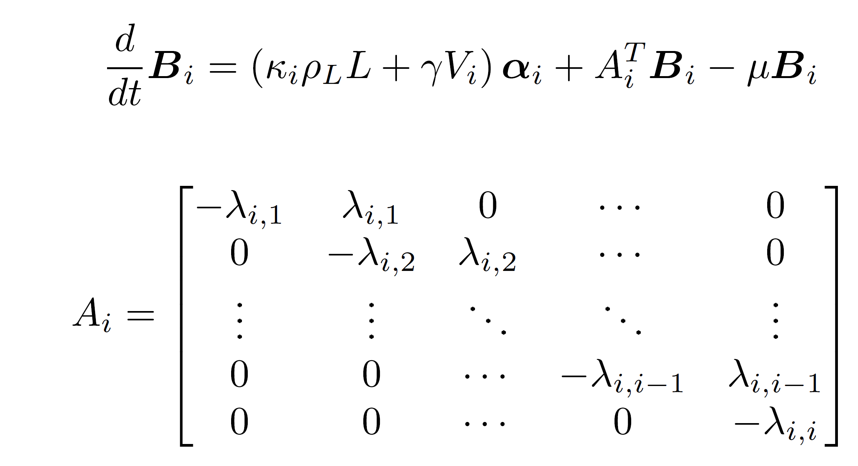

“Fate” model, specified
Blood-feeding stages
$$, 1≤i≤k$$

Slide 23
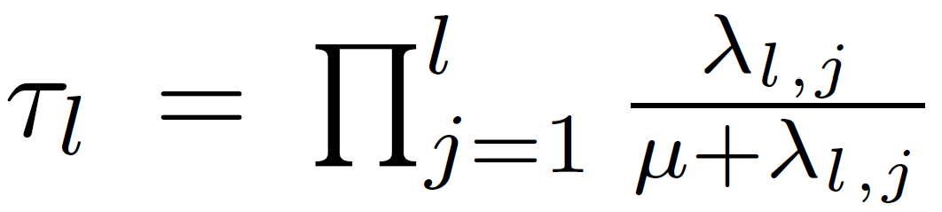
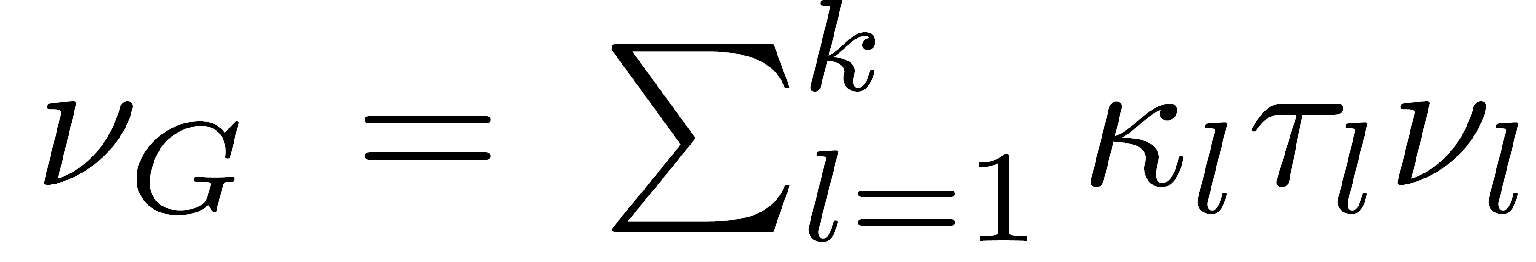
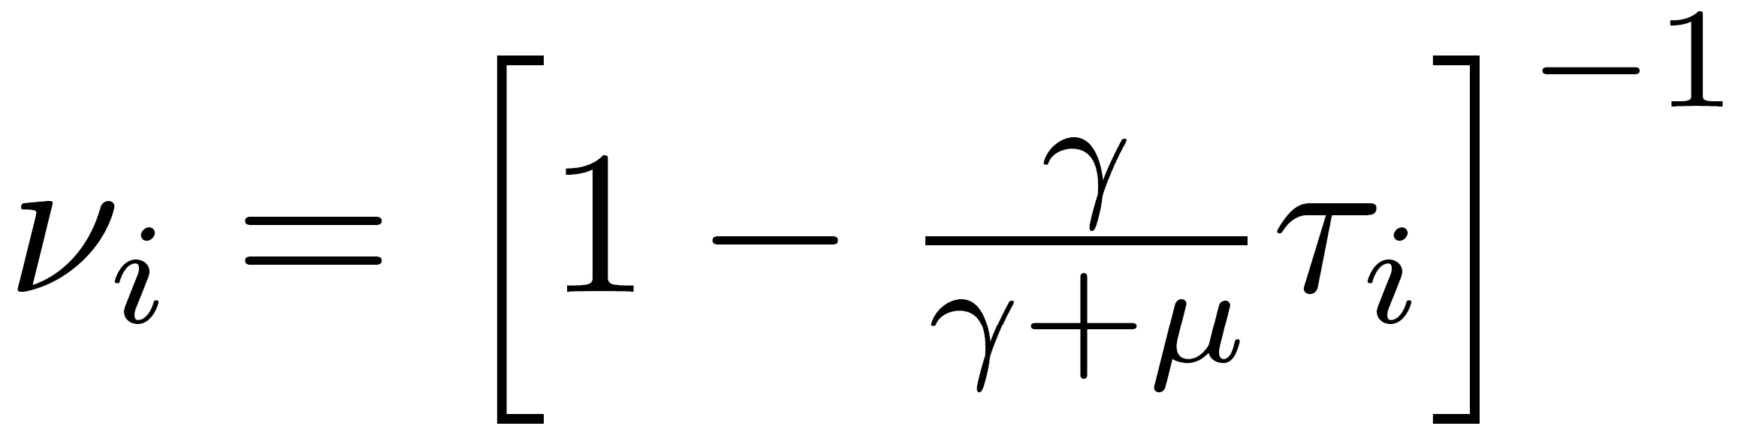
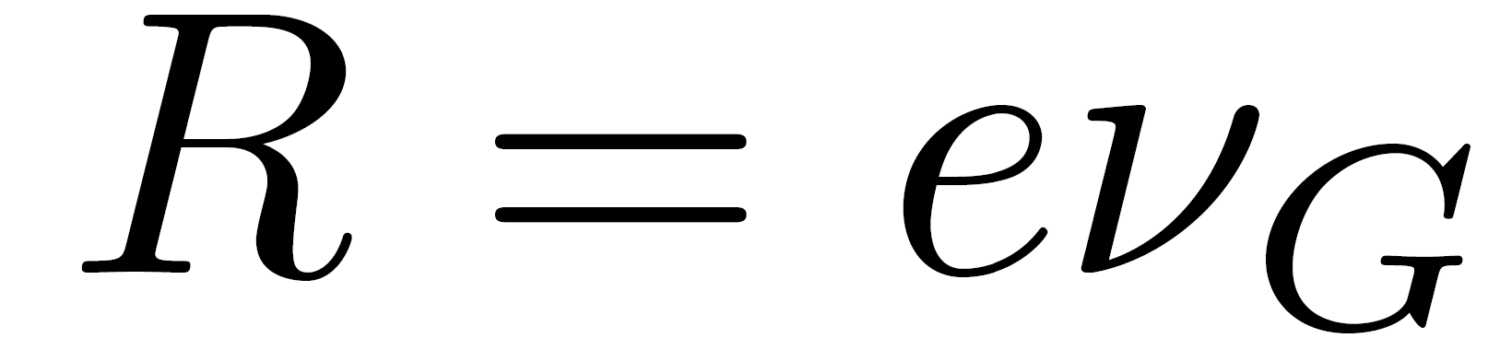
“Fate” model analysis
Probability of a newly-emerged mosquito of type l surviving to the oviposition stage
Weighted average of number of gonotrophic cycles survived by a newly-emerged mosquito
Average number of gonotrophic cycles in a lifespan for a mosquito of type i
Average number of new mosquitoes recruited by one mosquito in a single gonotrophic cycle
Probability of surviving the aquatic stage
Average number of eggs laid in one gonotrophic cycle

Slide 24
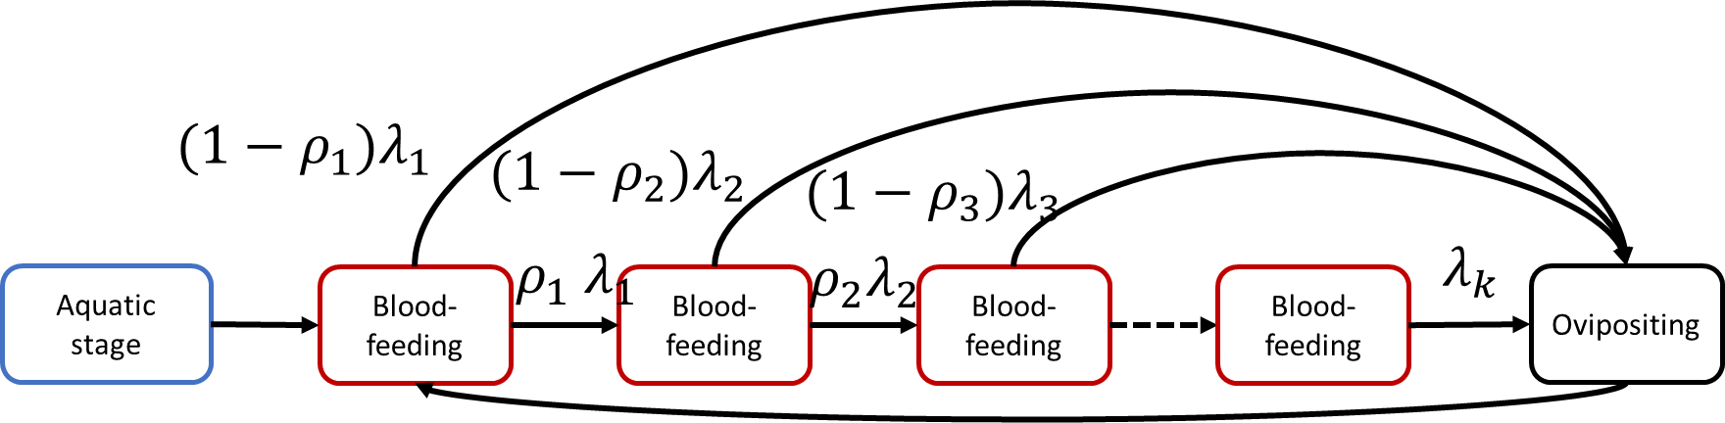
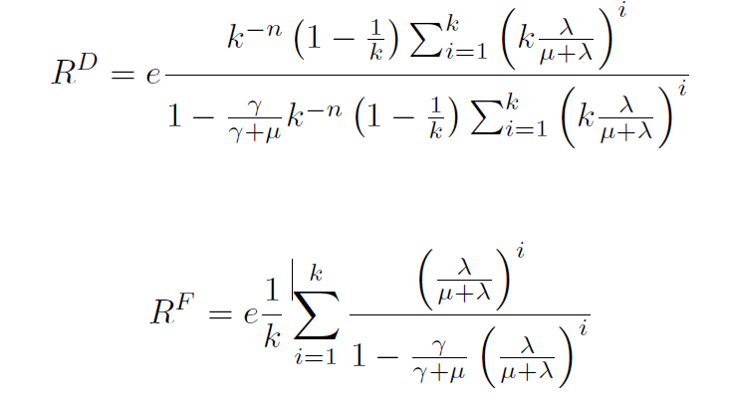
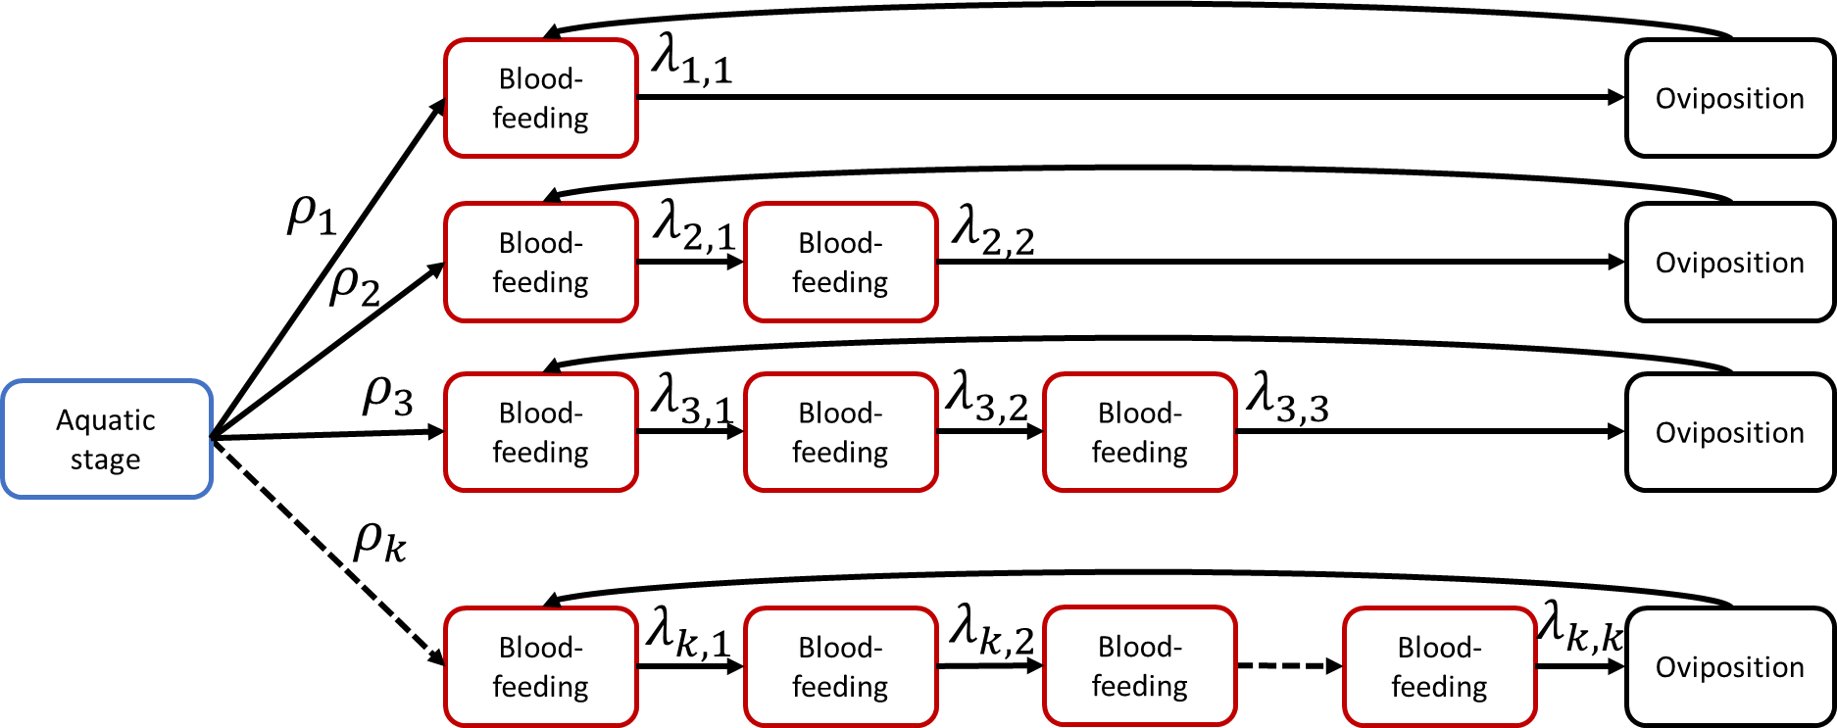
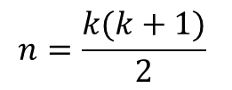
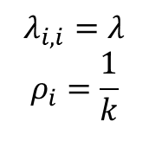
$$λ_{i,i}=λ$$
$$ρ_{i}=\frac{1}{k}$$
Fix “1-rho” and “rho” meaning the “same” thing in the two models
Rhos below need to sum to 1 but rhos above do not. They really have different interpretations
$$n=\frac{k(k+1)}{2}$$
Notes:
Given a fixed extrinsic incubation period, what fraction of compartments are potentially transmissible.
Assume all mosquitoes acquire infection on their first bite.

Slide 25
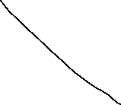
All lambdas equal
Biting rate is independent of mosquito life history
All lambdas equal
Proportions of mosquitoes taking i bites case 1:
Equal numbers from 1 to k
Proportions of mosquitoes taking i bites case 2:
It’s increasingly unlikely that a mosquito needs/takes i bites
Set the time to reach oviposition equal (no matter the cycle length)
(lambda_i,j=lambda_i)
Try a couple values
There’s a resource limitation driving the need to reach oviposition
Time to reach oviposition equal (no matter the cycle length)
Proportions of mosquitoes taking i bites case 2:
Proportions of mosquitoes taking i bites case 1:
Equal numbers from 1 to k

Slide 26
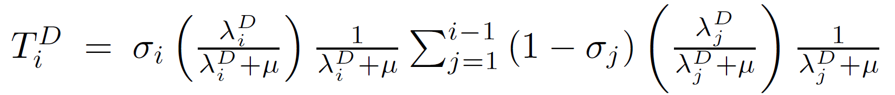
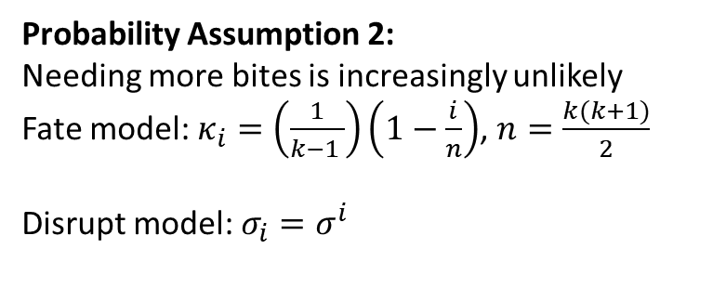
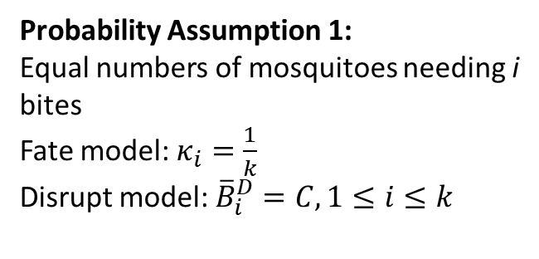
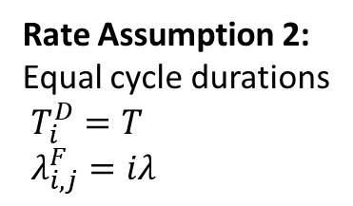
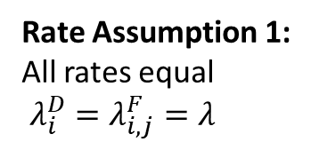
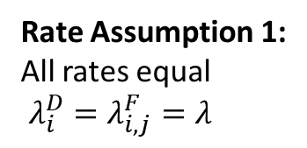
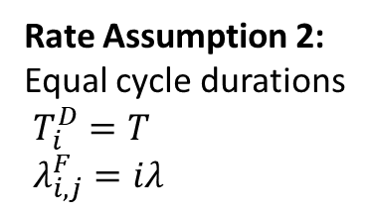
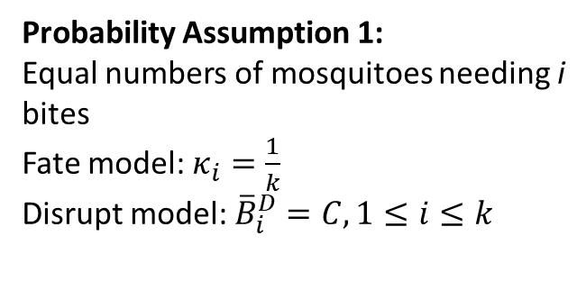
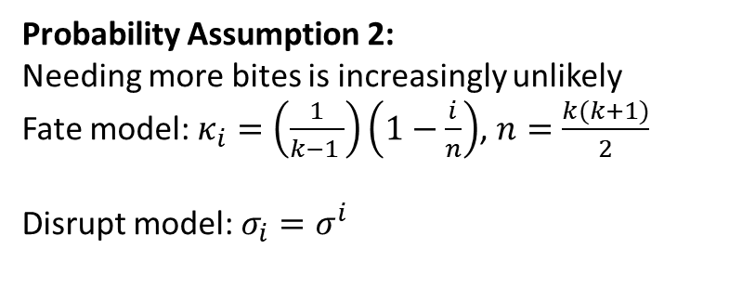
Rate Assumption 1:
All rates equal
$λ_{i}^{D}=λ_{i,j}^{F}=λ$
Rate Assumption 1:
All rates equal
$λ_{i}^{D}=λ_{i,j}^{F}=λ$
Probability Assumption 1:
Equal numbers of mosquitoes needing i bites
Fate model: $κ_{i}=\frac{1}{k}$
Disrupt model: ${\overline{B}}_{i}^{D}=C,1≤i≤k$
Probability Assumption 2:
Needing more bites is increasingly unlikely
Fate model: $κ_{i}=\left(\frac{1}{k−1 }\right)\left(1−\frac{i}{n}\right)$, $n=\frac{k(k+1)}{2}$
Disrupt model: $σ_{i}=σ^{i}$
Rate Assumption 2:
Equal cycle durations
$T_{i}^{D}=T$
$λ_{i,j}^{F}=iλ$
Rate Assumption 2:
Equal cycle durations
$T_{i}^{D}=T$
$λ_{i,j}^{F}=iλ$
Probability Assumption 2:
Needing more bites is increasingly unlikely
Fate model: $κ_{i}=\left(\frac{1}{k−1 }\right)\left(1−\frac{i}{n}\right)$, $n=\frac{k(k+1)}{2}$
Disrupt model: $σ_{i}=σ^{i}$
Probability Assumption 1:
Equal numbers of mosquitoes needing i bites
Fate model: $κ_{i}=\frac{1}{k}$
Disrupt model: ${\overline{B}}_{i}^{D}=C,1≤i≤k$

Slide 27
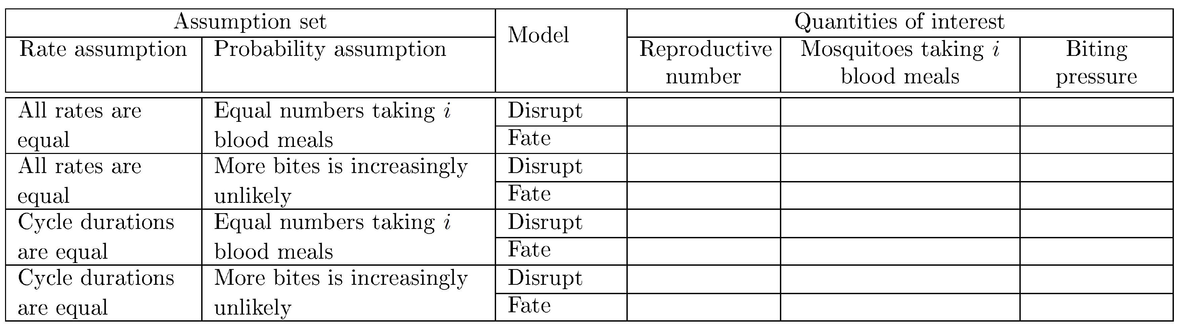
4 x 2 x 3 = 24 combinations
Vary k from 1 to 10
We obtain curves showing how the quantities vary with k
Figures:
Figure 1: Reproductive numbers vs. k
Linetype = model, color = assumption set
Figure 2: “i“ mosquitoes vs. k
Linetype = model, color = assumption set
Figure 3: Biting pressure vs. k
Linetype = model, color = assumption set
These figures should illustrate whether the two models produce similar ecological/epidemiological results when we parameterize them similarly.
In essence, we’re determining how sensitive the quantities are to the underlying assumptions for the multiple blood-feeding process.

Slide 28
To proceed, need to translate the rate and probability assumptions into parameterizations of the two models. This process is not necessarily straightforward.
After this, I’ll program the equations for each of the QoI x Assumption x Model combinations and calculate them across the range of k values we’re interested in.
Finally, I’ll plot the three figures described in the previous page.

Slide 29
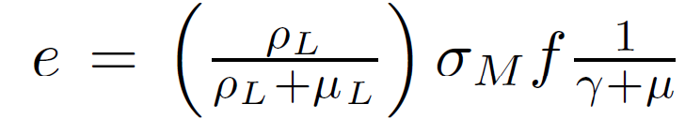
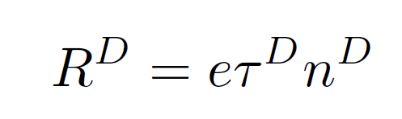
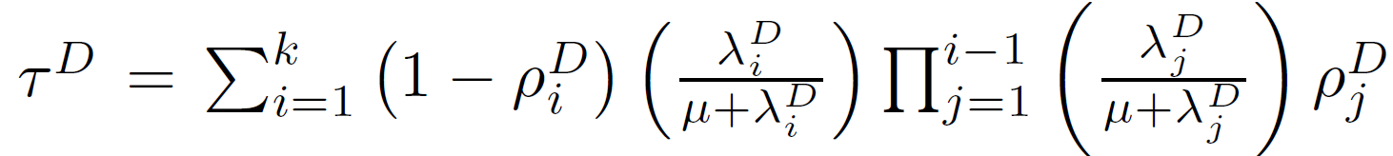
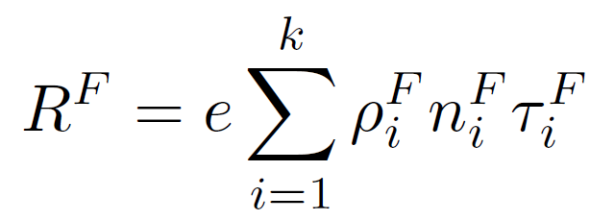
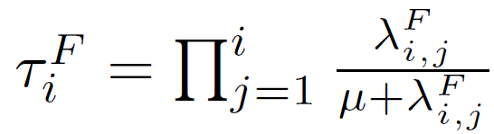
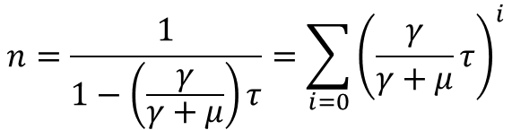
Reproductive numbers
Viable eggs per female per oviposition cycle:
Total probability of surviving to reach oviposition stage:
$$n=\frac{1}{1−\left(\frac{γ}{γ+μ}\right)τ}=\sum_{i=0}{{\left(\frac{γ}{γ+μ}τ\right)}^{i}}$$
Total probability of surviving to reach oviposition stage for mosquitoes of type i:

Slide 30
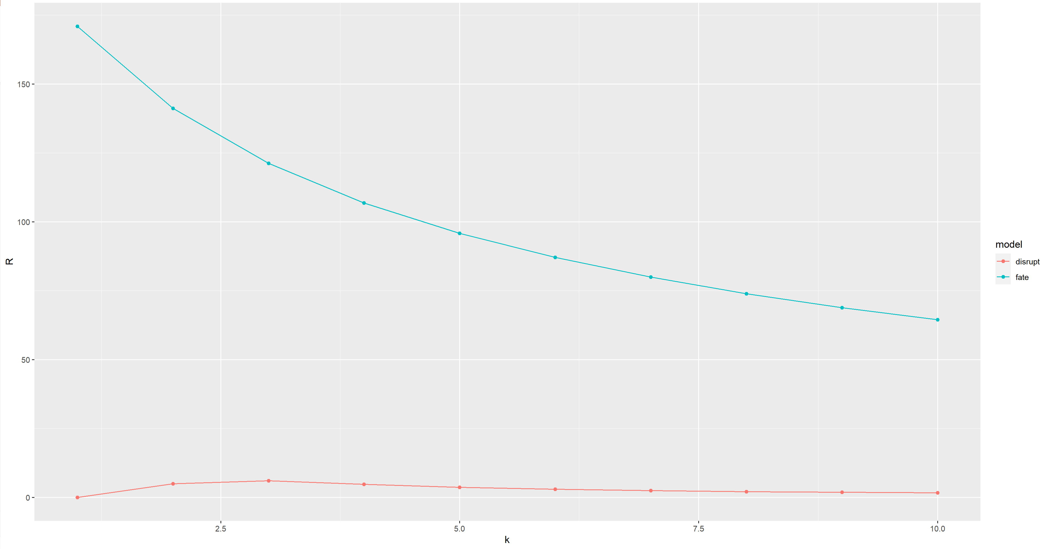

Simple case: All $λ$’s = $λ$, all $ρ$’s =1/k
All $ρ$’s = $\frac{1}{k}$

Slide 33
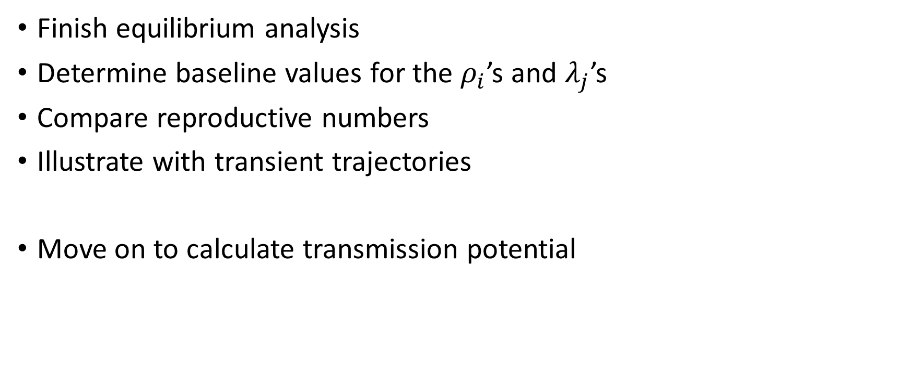
Next steps
Finish equilibrium analysis
Determine baseline values for the $ρ_{i}$’s and $λ_{j}$’s
Compare reproductive numbers
Illustrate with transient trajectories
Move on to calculate transmission potential

